Slide 1
Final Project: Men’s Fashion Stores
By Karan Daiya

Slide 2
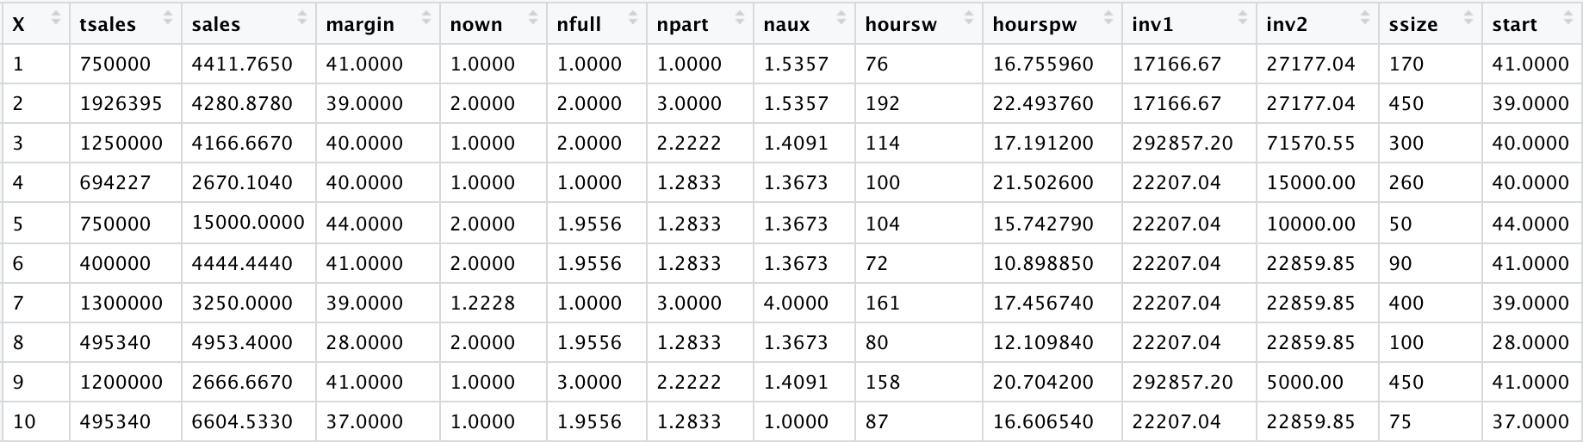
Dataset:
The above shown dataset is of men’s fashion stores located in Netherland. There are 400 rows in total.
I got attracted the most towards this dataset as my dad owns multiple showrooms of men’s formal wear in India and my future plan is to expand my family business as much as I can so performing analysis on this small dataset will give me a start-up exposure in this specific field.

Slide 3
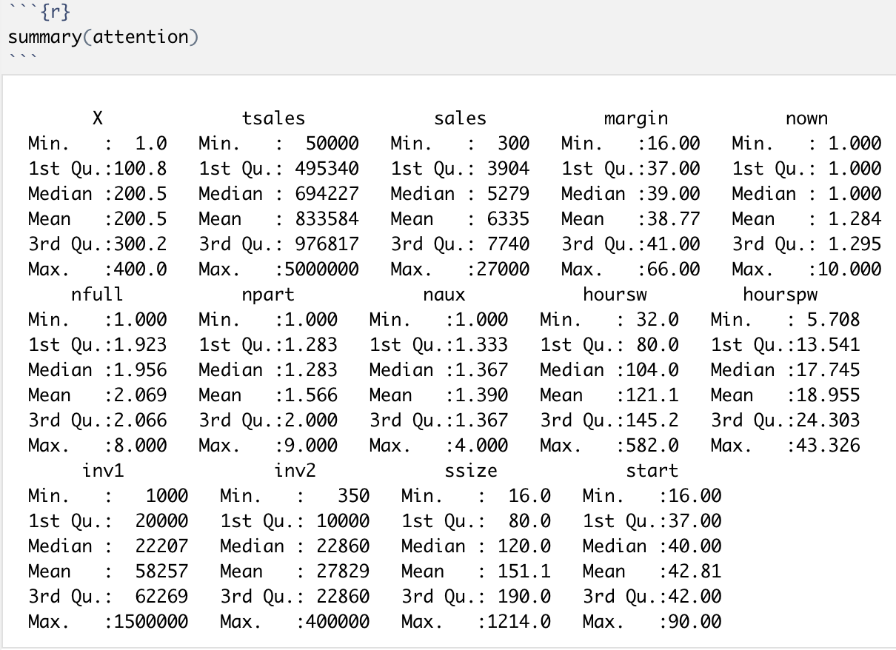
Summary:
The summary() function elaborates the detailed summary of every variables in the dataset.
From the 400 rows of data, the highest annual sale was of 50,00,000 and the lowest was of 50,000.
The highest gross-profit margin was 66.00 and the lowest was 16.00 only.

Slide 4
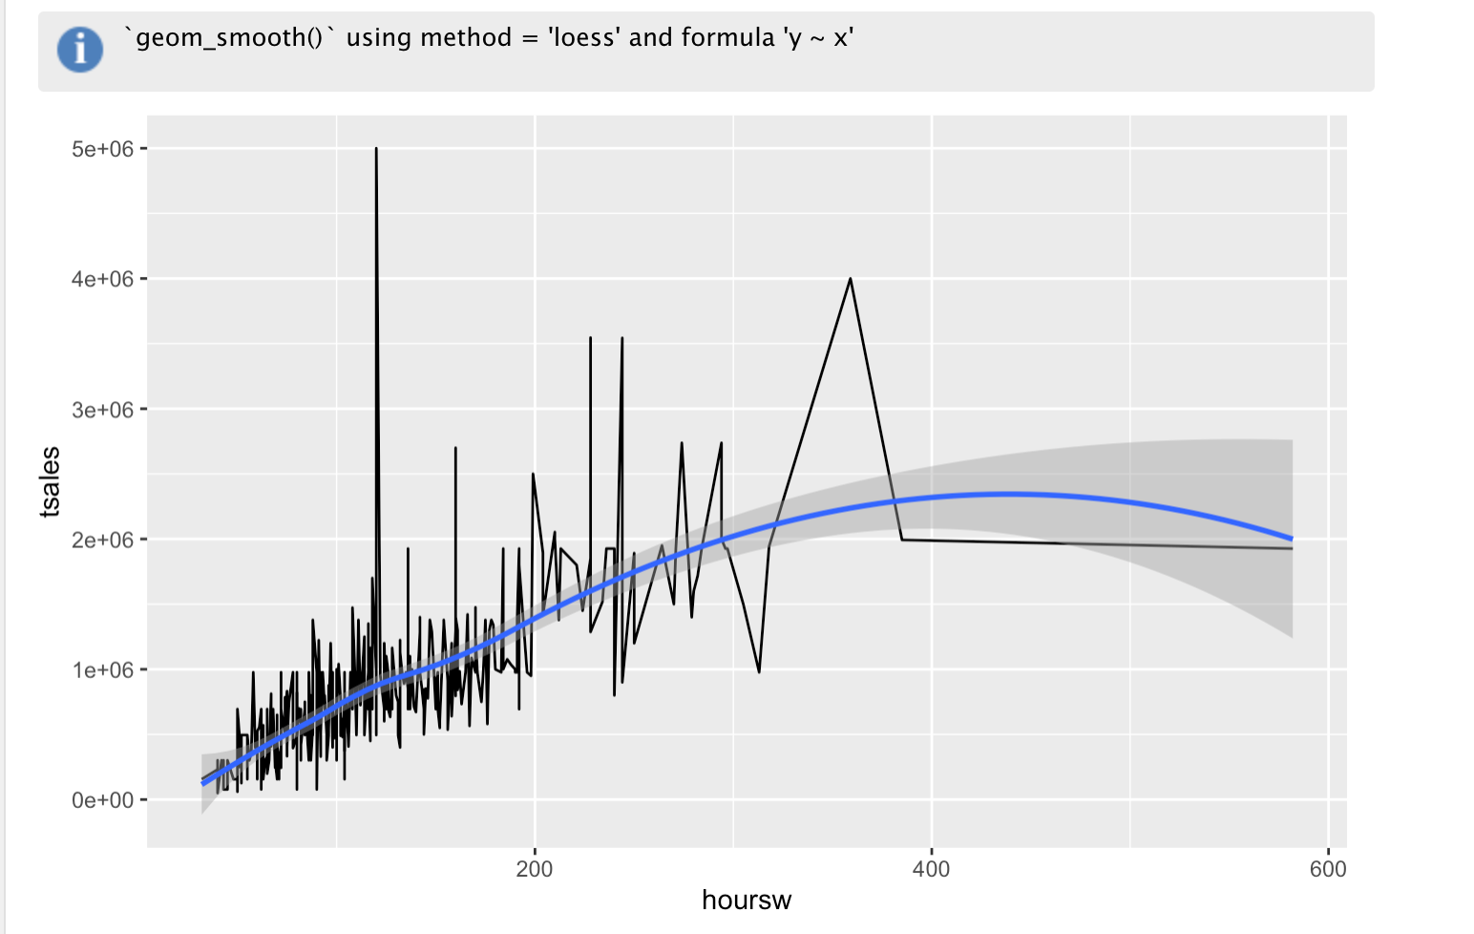
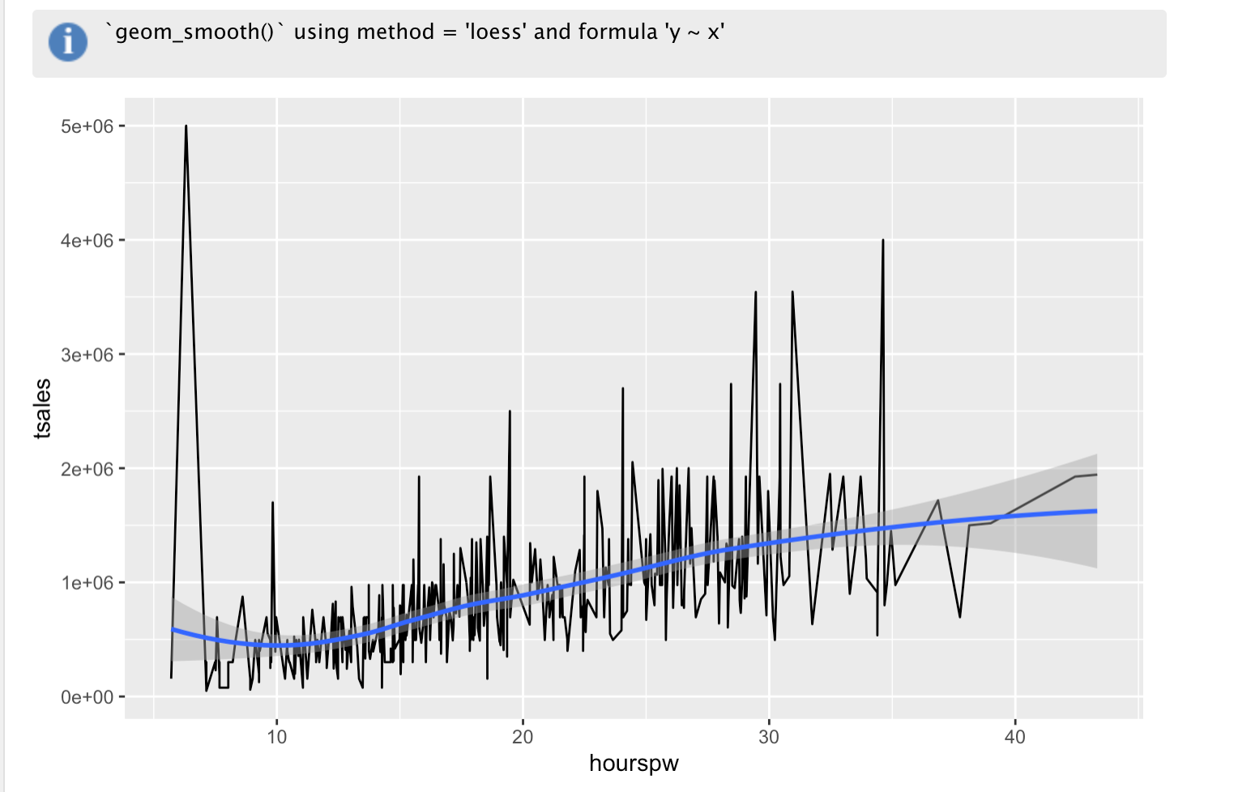
Splitting annual sales by total hours worked & hours per worker.
As you can see from the above line charts that maximum number of sales was done when the workers have worked around 121 hours and hours per worker was around 10 to 30 hours.

Slide 5
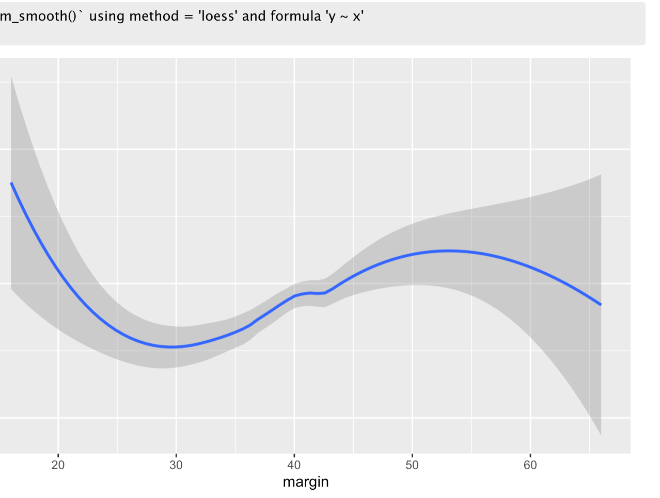
Total sales vs Margin:
ggplot(model, aes(margin, tsales)) + geom_smooth() is used to create the chart.
The chart clearly shows that when the margin is low, the total sale gets higher.
But according to the chart, the optimal margin should be around 40 to 50.

Slide 6
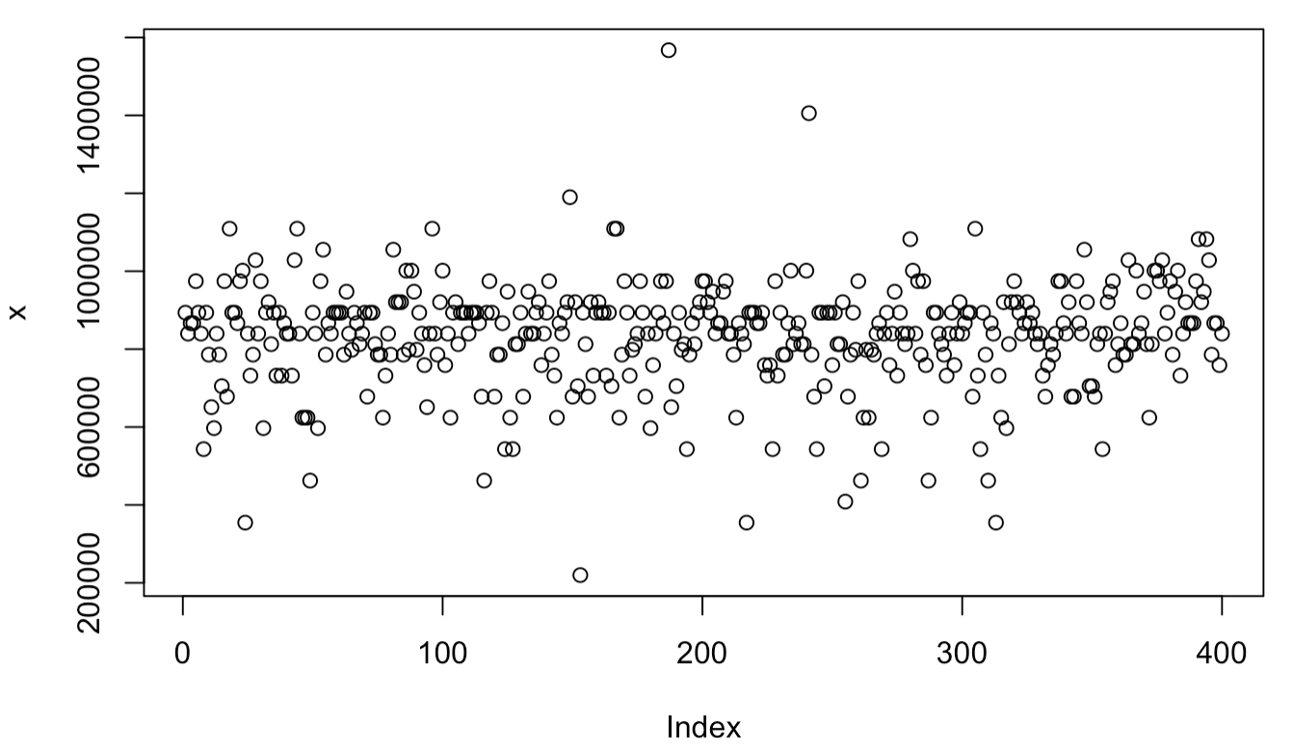
Predicted Model:
model <- lm(tsales ~ margin, data = attention)
model
x <- predict(model)
The chart shows the predicted model which is created by using predict() function.
Y-axis denotes the number of fashion stores.
X-axis denotes the gross-profit margin.

Slide 7
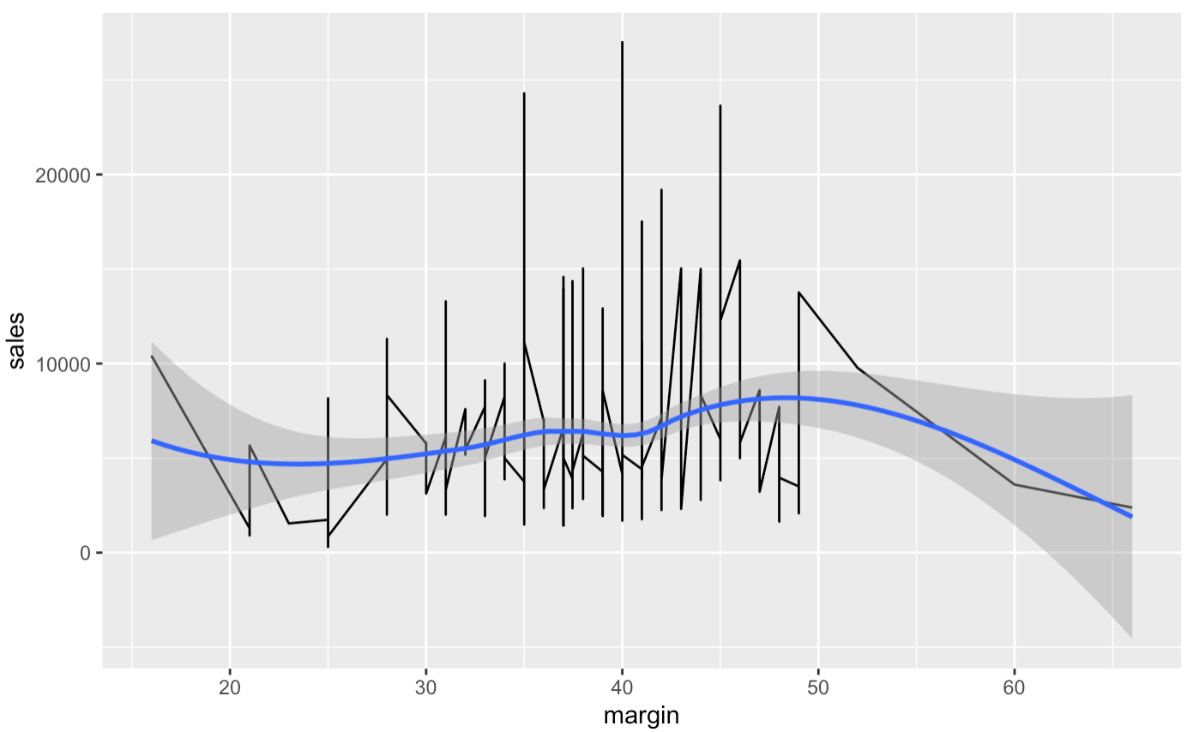
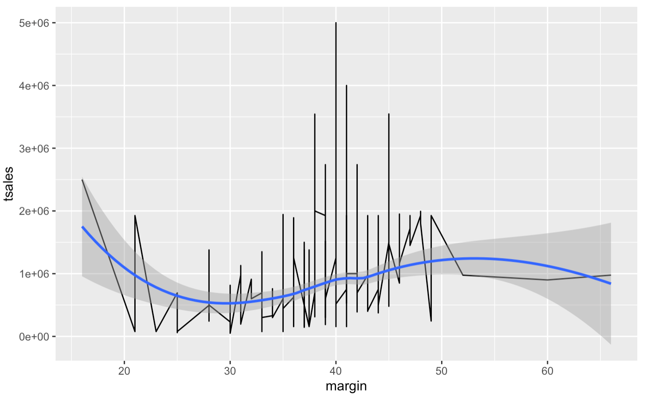
Splitting Margin Vs total annual sales and sales per square meter.
After plotting these two plots, we can easily tell by looking that most of the sales was done when the gross-profit margin was around 30 to 50.

Slide 8
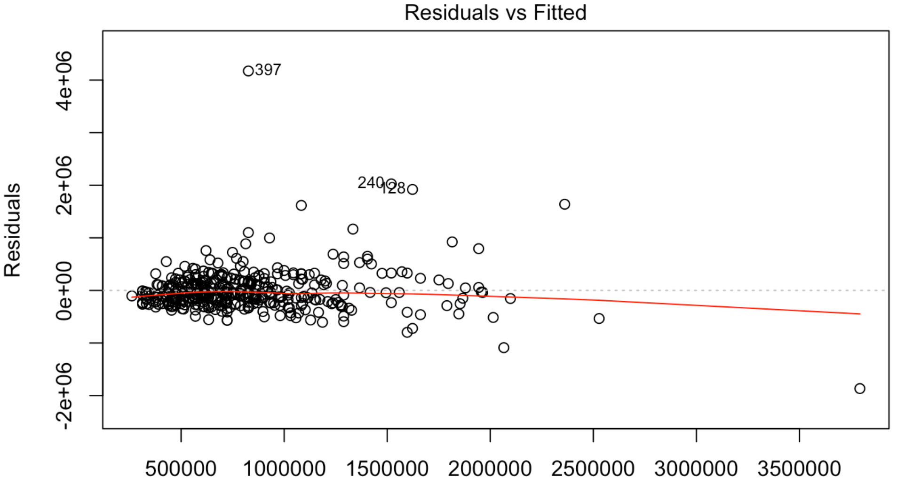
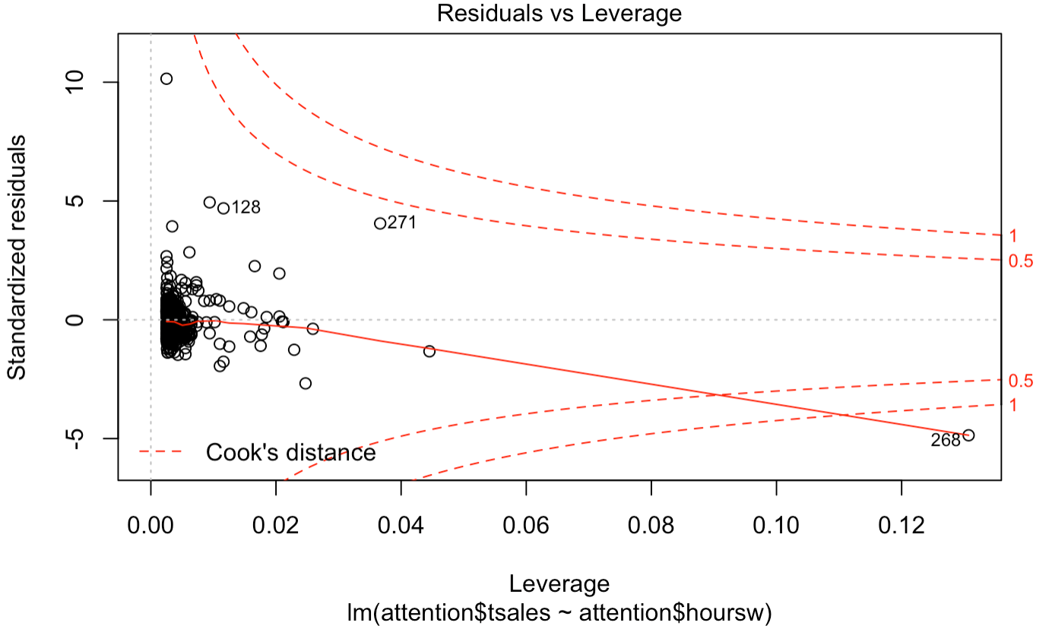
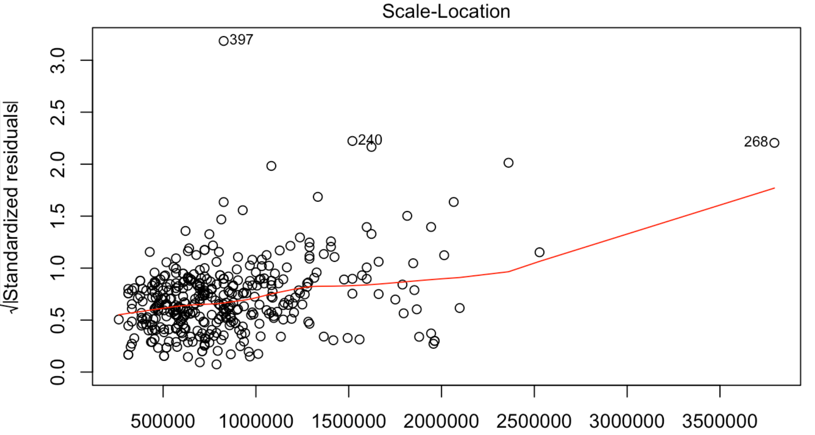
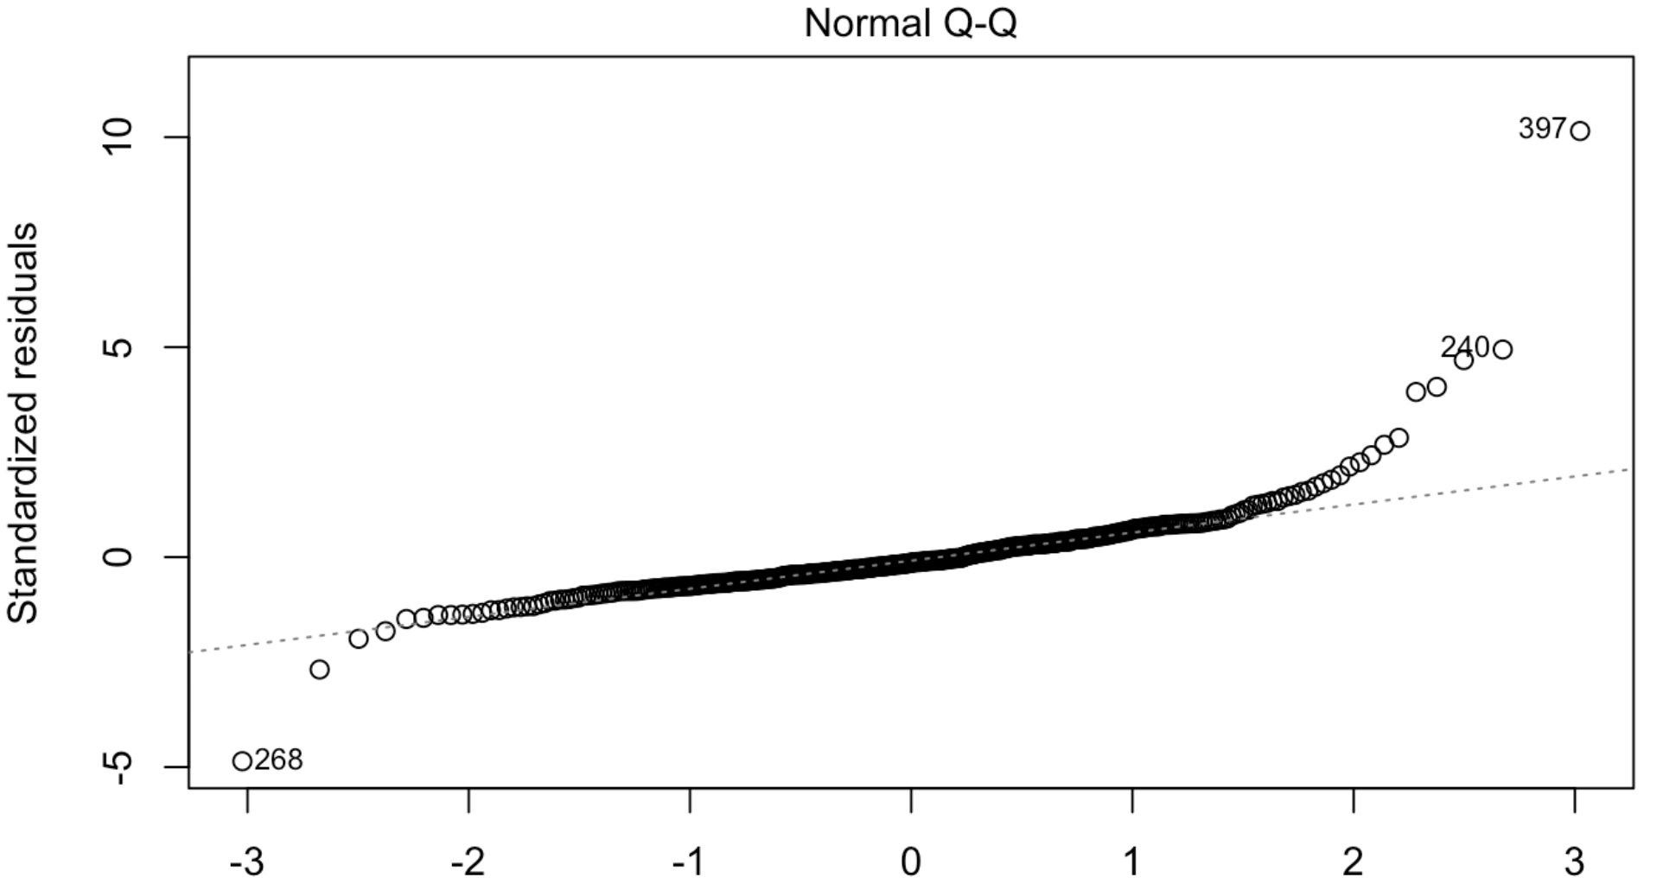
Regression:
By applying multiple regression these charts can be plotted.
A Q-Q plot is a scatterplot created by plotting two sets of quantiles against one another. If both sets of quantiles came from the same distribution, we should see the points forming a line that’s roughly straight.

Slide 9
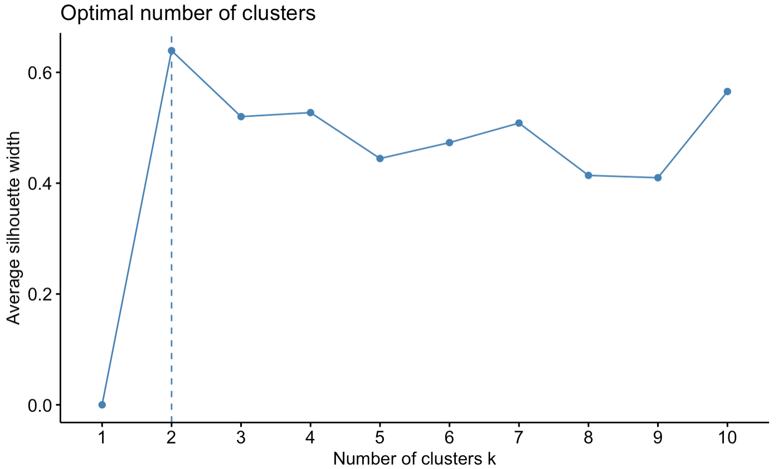
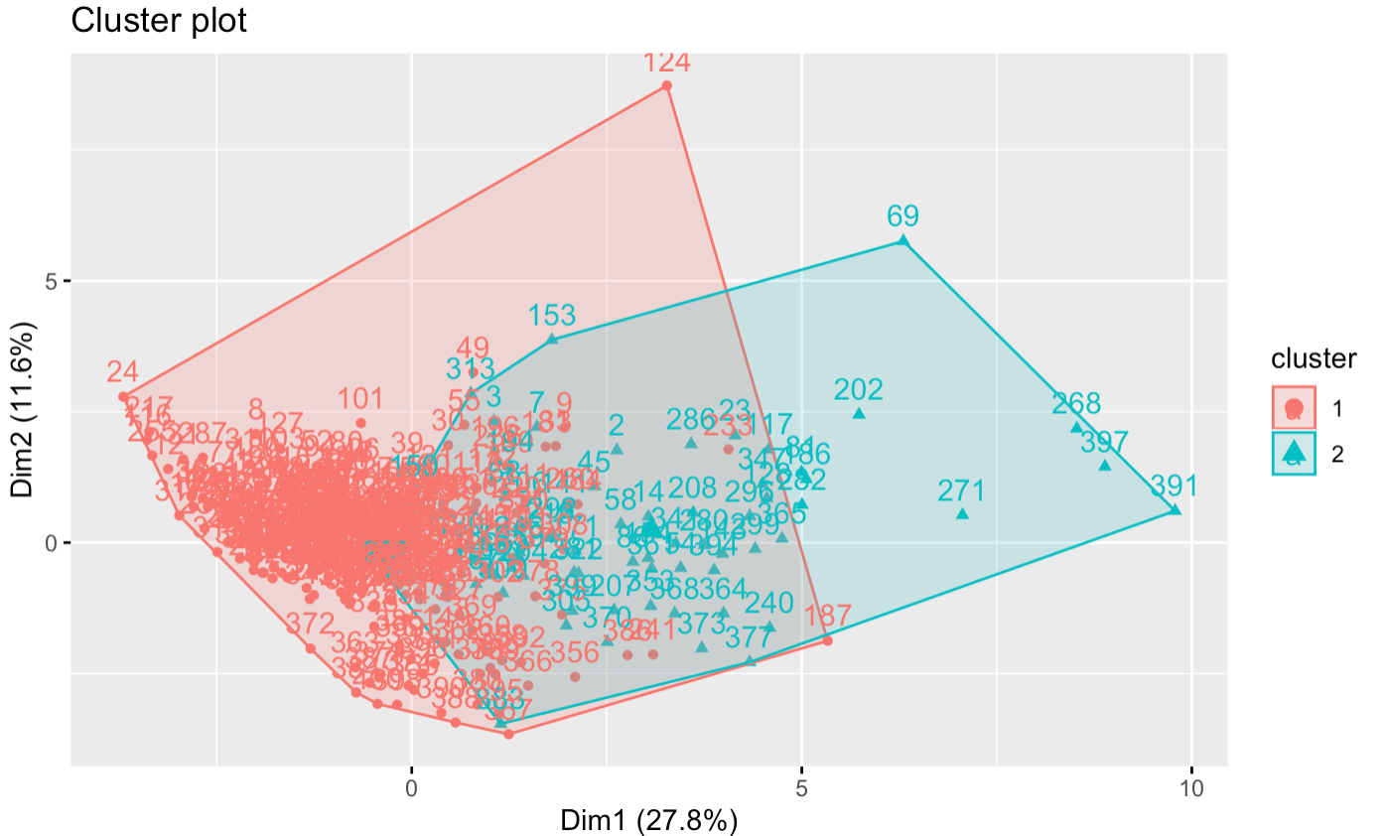
Clustering
Using fviz_nbclust() function, optimal number of clusters can be obtained.
The below plot is a Cluster plot which is created from the below code in R Studio.
k2 <- kmeans(attention, centers = 2, nstart = 25)
str(k2)
fviz_cluster(k2, data = attention)

Slide 10
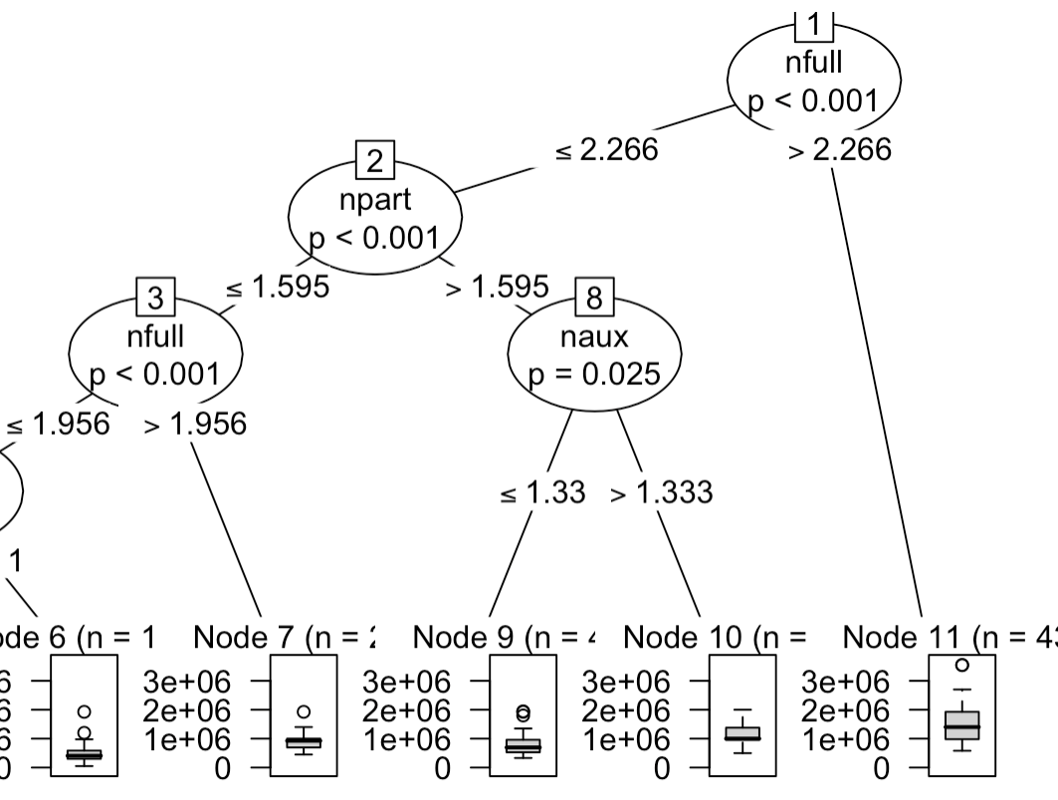
Decision Tree:
The root node represents the sample and below are the subsets of main dataset.
A node, which is divided into sub-nodes is called a parent node of the sub-nodes; whereas the sub-nodes are called the child of the parent node.

Slide 11
Thank you
By: Karan Daiya
NUID: 001083274
ALY 6015: Intermediate Analytics
Northeastern University: College of Professional Studies

